Slide 1



Week 15
EXPLORATORY DATA ANALYSIS
https://intip.in/EDAIUP2022
Teaching Assistant :
Bramandika (06211940000059)
Maura Putri Defa (06211940000139)
Sepuluh Nopember Institute of Technology, Surabaya - Indonesia

Slide 2
Median Polish
Objectives
Able to identify a median polish.
Able to identify steps in making a median polish.
Able to make a median polish using software.
‹#›
Notes:
https://www.youtube.com/watch?v=Vf7oJ6z2LCc

Slide 3
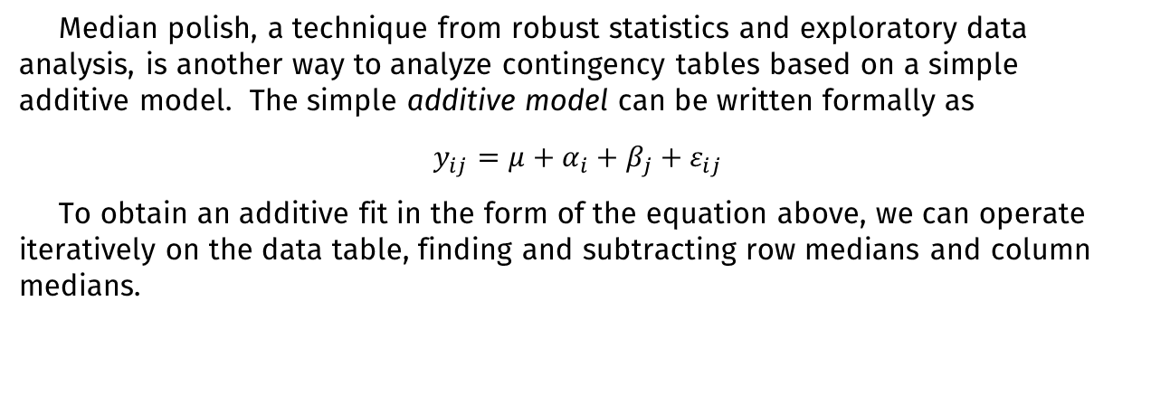
Review

Slide 4
The median polish procedure is as follows:
Take the median of each row and record the value to the side of the row. Subtract the row median from each point in that particular row.
Compute the median of the row medians, and record the value as the grand effect. Subtract this grand effect from each of the row medians.
Take the median of each column and record the value beneath the column. Subtract the column median from each point in that particular column.
Compute the median of the column medians, and add the value to the current grand effect. Subtract this addition to the grand effect from each of the column medians.
Repeat steps 1-4 until no changes occur with the row or column medians.

Slide 5
The result of median polish can help to better understand the contingency table. In the ideal case, the residuals are zero or at least close to zero. Close to zero means in comparison to the row or column effects. If most of the residuals are close to zero, but only a few have a large absolute value, this is an indicator for outliers that might be of interest.

Slide 6
Dataset
Infant mortality rates in the United States, all races, 1964-1966, by region and father’s education. (Entries are numbers of deaths per 1000 live births.)
Region | Education of Father (in years)
 | < 8 | 9 - 11 | 12 | 13 - 15 | > 16
Northeast | 25,3 | 25,3 | 18,2 | 18,3 | 16,3
North Central | 32,1 | 29 | 18,8 | 24,3 | 19
South | 38,8 | 31 | 19,3 | 15,7 | 16,8
West | 25,4 | 21,1 | 20,3 | 24 | 17,5

Slide 7
Practice: Using Minitab
Step 1:
Perform the median polish
Open the worksheet. Choose Stat > EDA > Median Polish.
In Response, enter Result.
In Row factor, enter Region. In Column factor, enter Education.
In Common effect, type CommonEffect. In Row effects, type RowEffect. In Column effects, type ColumnEffect.
Check Residuals. Click OK.
Notes:
https://towardsdatascience.com/lowess-regression-in-python-how-to-discover-clear-patterns-in-your-data-f26e523d7a35

Slide 8
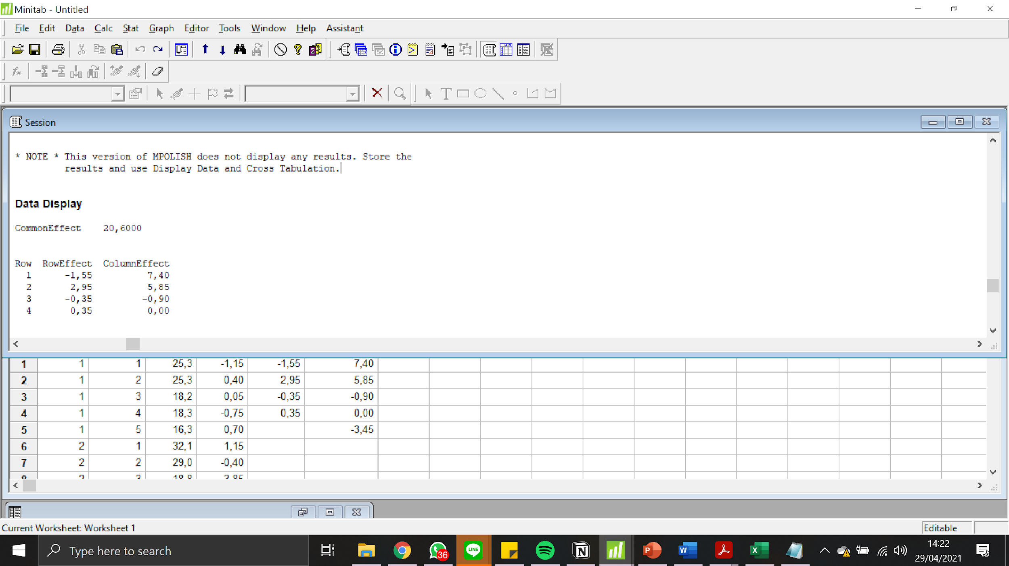
Practice: Using Minitab
Step 2:
Display the common, row, and column effects
Choose Data > Display Data.
In Columns, constants, and matrices to display, enter CommonEffect, RowEffect, and ColumnEffect. Click OK.
Step 2:
Session window output
Notes:
https://towardsdatascience.com/lowess-regression-in-python-how-to-discover-clear-patterns-in-your-data-f26e523d7a35

Slide 9
Practice: Using Minitab
Step 3:
Display the data and residuals
Choose Stat > Tables > Descriptive Statistics.
Under Categorical variables, in For rows, enter Region. In For columns, enter Education.
Under Display summaries for, click Associated Variables.
Under Associated variables, enter Resi1. Under Display, check Data. Click OK.
Under Display summaries for, click Categorical Variables.
Under Display, uncheck Counts. Click OK.
Click Options. Under Display marginal statistics for, choose No variables. Click OK in each dialog box.
Notes:
https://towardsdatascience.com/lowess-regression-in-python-how-to-discover-clear-patterns-in-your-data-f26e523d7a35

Slide 10
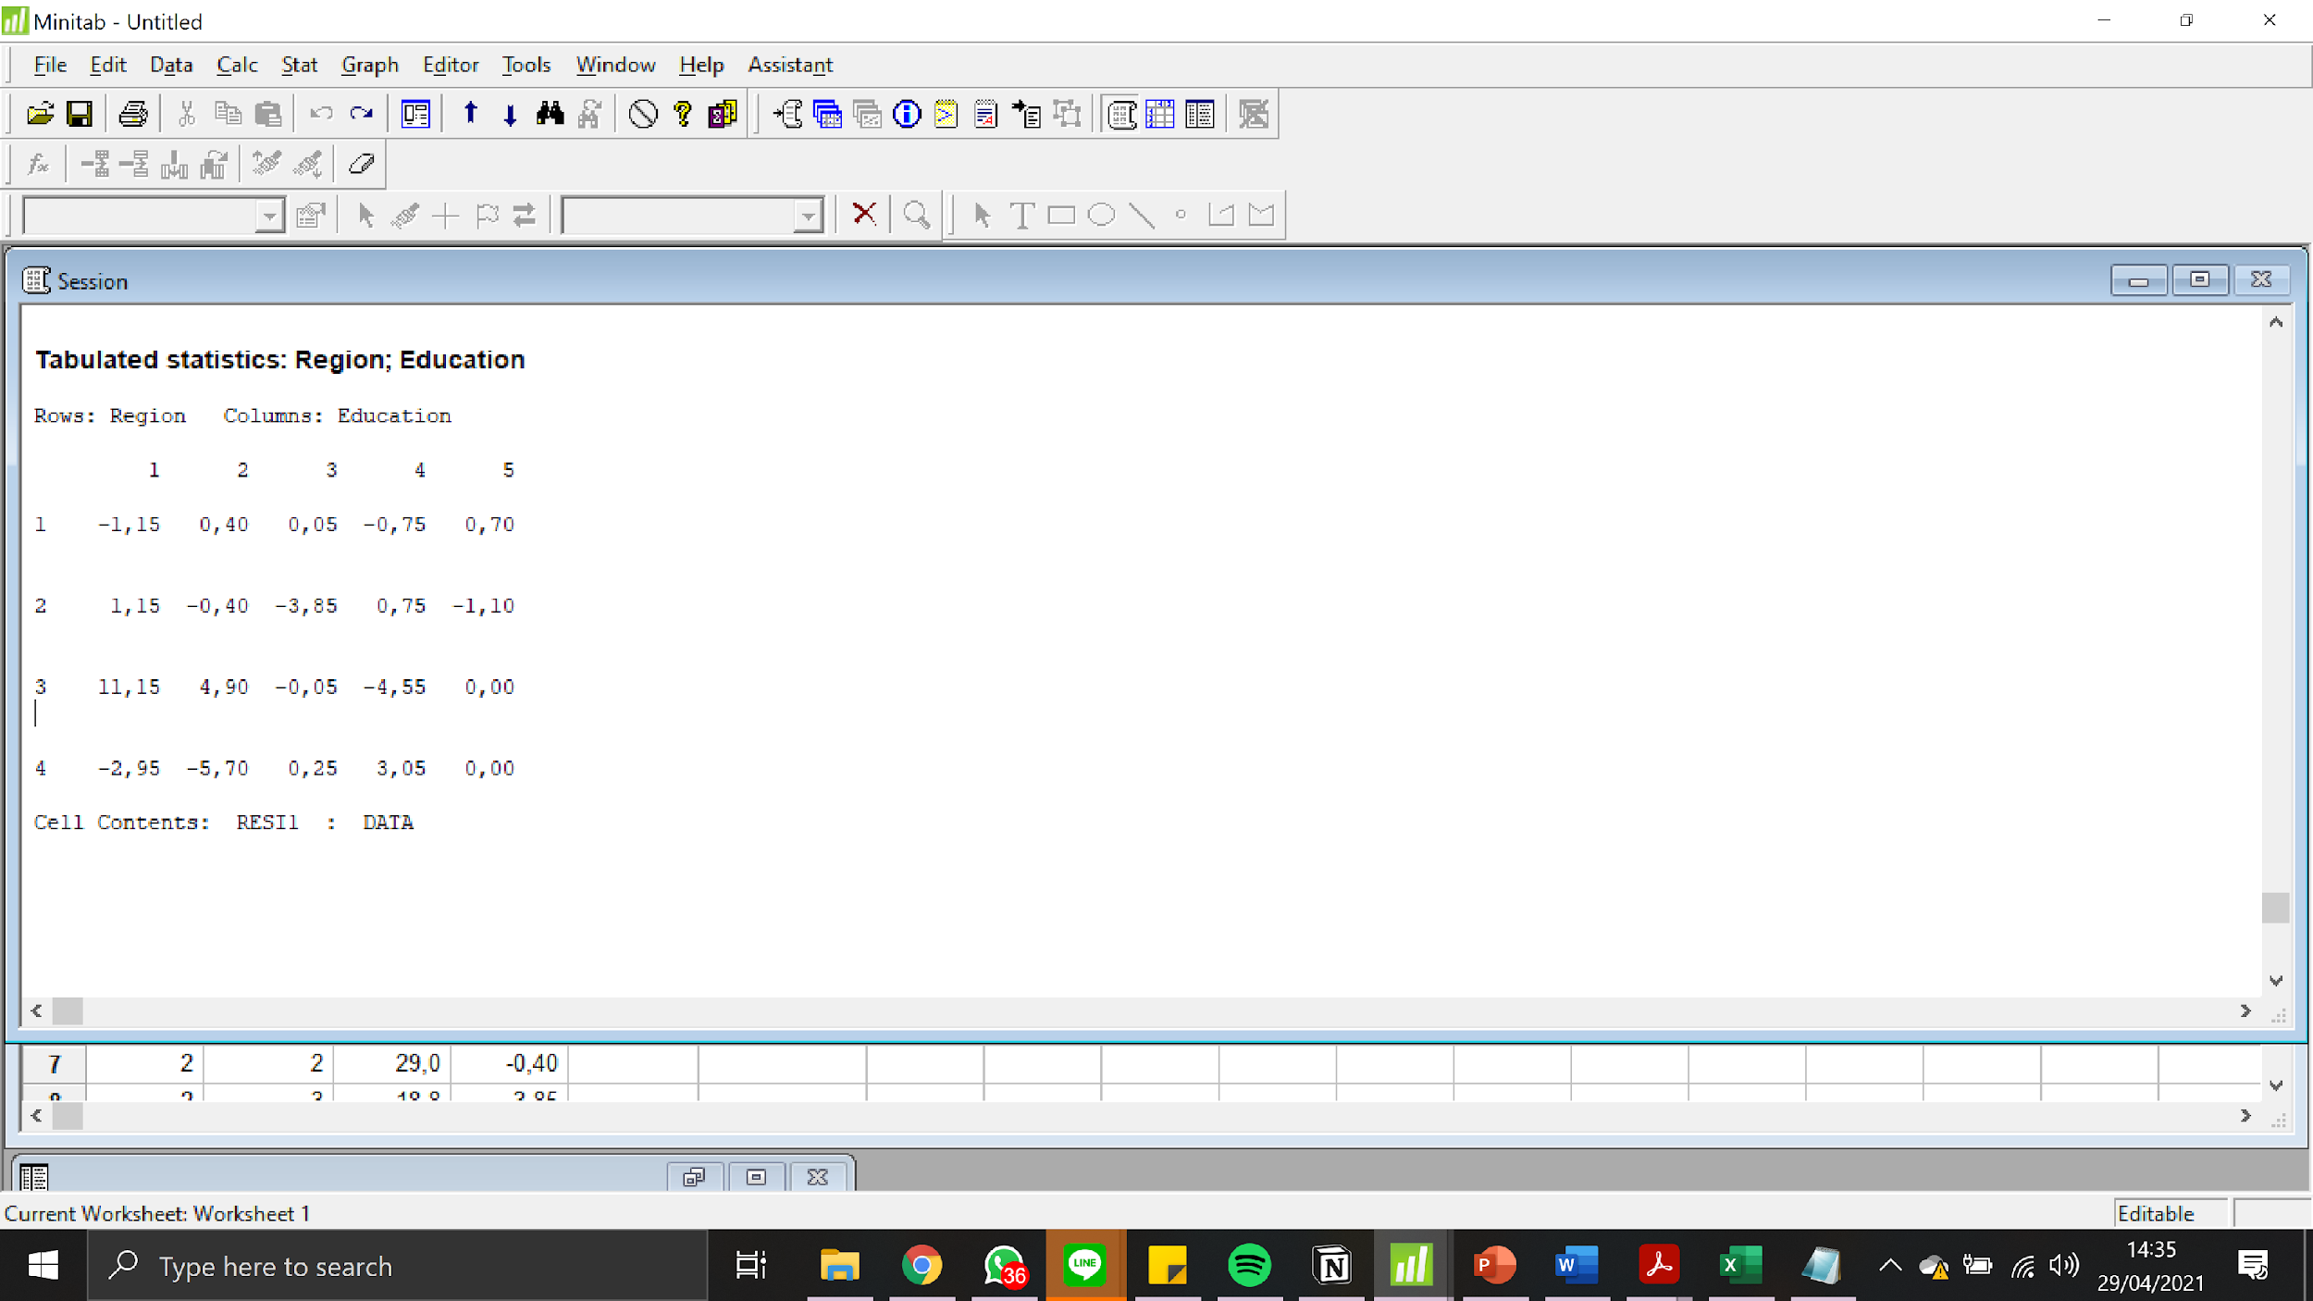
Practice: Using Minitab
Step 3:
Session window output
Notes:
https://towardsdatascience.com/lowess-regression-in-python-how-to-discover-clear-patterns-in-your-data-f26e523d7a35

Slide 11
Thank you!

